Slide 1
Debugging in Angular

Slide 2
Debugging is the process of detecting and removing of existing and potential errors (also called as 'bugs') in a software code that can cause it to behave unexpectedly or crash.
To prevent incorrect operation of a software or system, debugging is used to find and resolve bugs or defects.

Slide 3
Debug angular in VS code
Step 1: Create an Angular application;
Step 2: Install Debugger for Chrome (you could install other debuggers you like)
Step 3: Configure Debug Environment;
Step 4: Start Debugging;

Slide 4
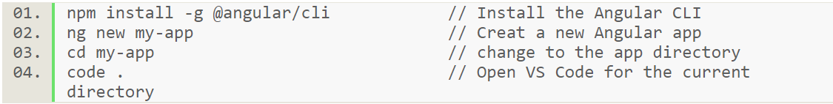
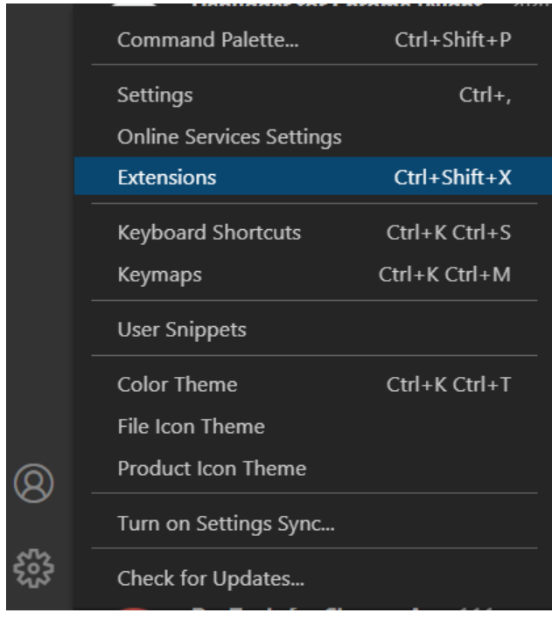
Step 1 - Create an Angular application
We use the Angular CLI to create projects
Step 2 - Install Debugger for Chrome
In VS Code environment: Left Click Manage (Left Bottom Corner) > Extensions (or Ctrl+Shift+X)

Slide 5
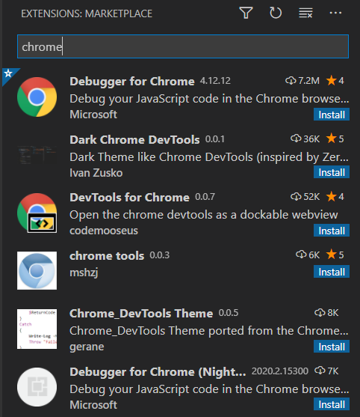
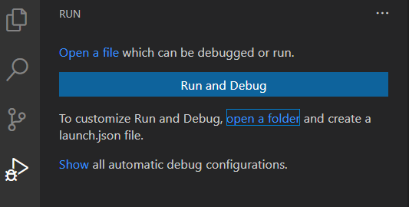
Open the Extensions view. Then type 'chrome' in the search box.
You'll see the extensions: Debugger for Chrome. Press the Install button for Debugger for Chrome
Step 3 - Configure Debug Environment
In VS Code environment: Click Run Button on the left side (or Ctrl+Shift+D) .
If running and debugging is not yet configured (no launch.json has been created), VS Code shows the Run start view,
You can configure the environment by creating launch.json file yourself manually, but you can do that automatically by Clicking the Run and Debug button to open the Select Environment dialog box

Slide 6
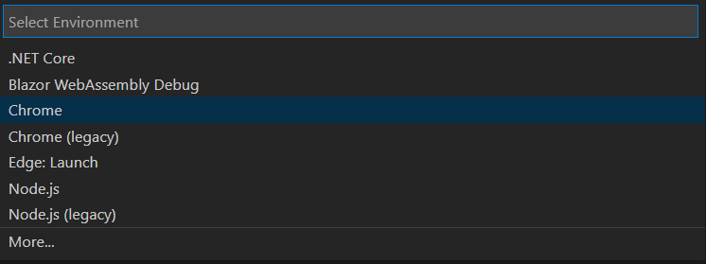
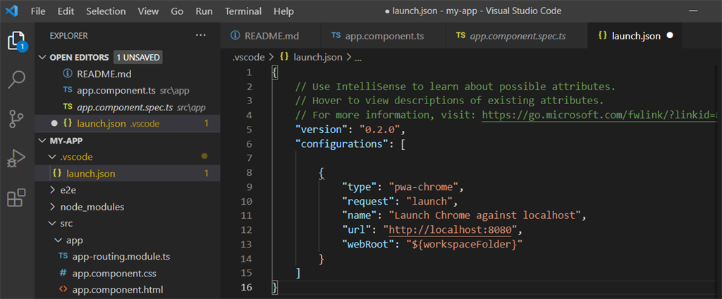
Select Chrome, then VS Code will create an launch.json.
You might need to change the port to what your app running on, say, 4200.

Slide 7
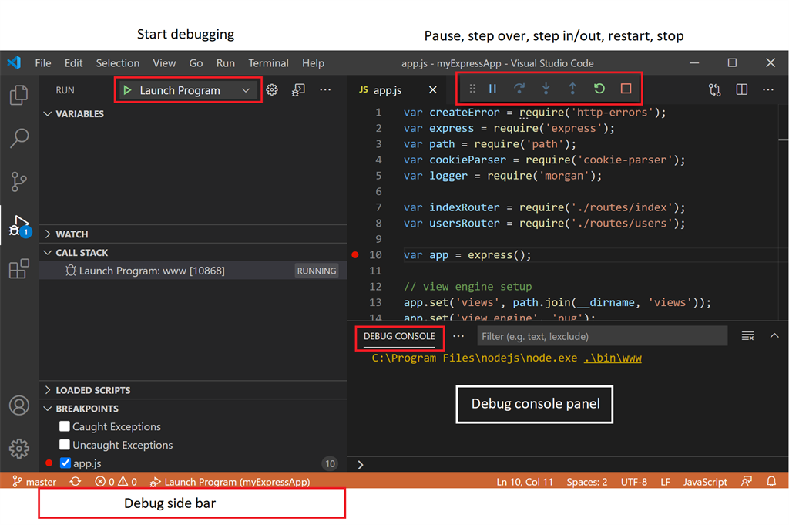
Step 4 - Start Debugging
Now, in VS Code, if you Click Run Button on the left side (or Ctrl+Shift+D), you will have a debugging environment like this.

Slide 8

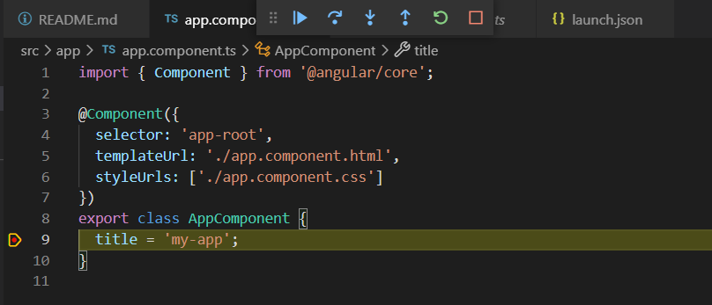
Run the app from the Angular CLI (very important, otherwise the debugging will not work) by command : ng server -o
You will see the app running.
Now, set your breakpoint, and run debug,
Once a debug session starts, the Debug toolbar will appear on the top of the editor.
Continue / Pause F5
Step Over F10
Step Into F11
Step Out Shift+F11
Restart Ctrl+Shift+F5
Stop Shift+F5

